Slide 1
PREDICTION OF CHRONIC KIDNEY DISEASE
Team UPMOST

Slide 2
Sai Srihitha Goverdhana
Vivek Reddy Gurrala
Bhanu Prakash Konda
Rama Sai Reddy Chinthamreddy
Ravi Teja Gorantla
Sowmya Komirelli

Slide 3
TABLE OF CONTENTS
01
02
03
BUSINESS PROBLEM
04
PROJECT PLAN &
EXECUTION
DESCRIPTION OF DATA
05
CONCLUSION
SUMMARY OF DATA CLEANING

Slide 4
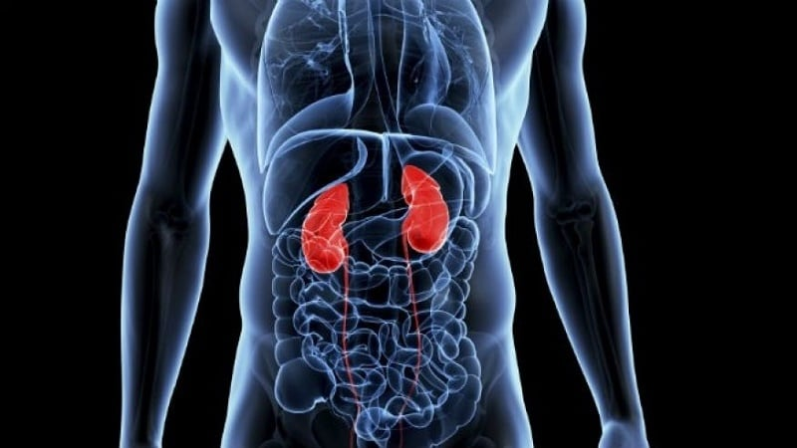


BUSINESS PROBLEM
01
Our Aim is to Determine if a person needs to be diagnosed for CKD based on Few Components.
This will potentially reduce the workload for medical professionals and diagnostic services.
Early diagnosis can also aid in reducing the disease's severity and eliminate the socioeconomic stress on the families.

Slide 5
WHAT IS CHRONIC KIDNEY DISEASE(CKD)?
WHAT ARE THE CAUSES FOR CKD ?
HOW DOES THIS IMPACT ?
ML ROLE IN HEALTH CARE

Slide 6
DATA DESCRIPTION
02
Dr.P.Soundarapandian.M.D.,D.M (Senior Consultant Nephrologist), Apollo Hospitals, Managiri, Madurai Main Road, Karaikudi Tamilnadu, India.
Data Source
Data Set
400 Instances
25 Attributes (11- Numerical & 14- Nominal)
The target is the ‘classification', which is either 'ckd' or 'notckd' - ckd=chronic kidney disease.
Target Variable

Slide 7
Summary of Data Cleaning
03
Load the Data
400 Entries
Cleaning up Categorical Data
26 Columns
Filtering Attributes
Handling Null Values
Feature Encoding
Target – CKD(150), NCKD (250)
NUM- Filled up with Median and Mode
CAT- Filled up Random Values
Selecting Major Predictors from Data Set
Numerical Data cleaning

Slide 8
IMPORTANT PREDICTORS
Sugar
Hypertension
White Blood Cell - WBC
Blood Urea
Blood Glucose Random
Serum Creatinine
Packed Cell Volume
Albumin
Haemoglobin
Age

Slide 9
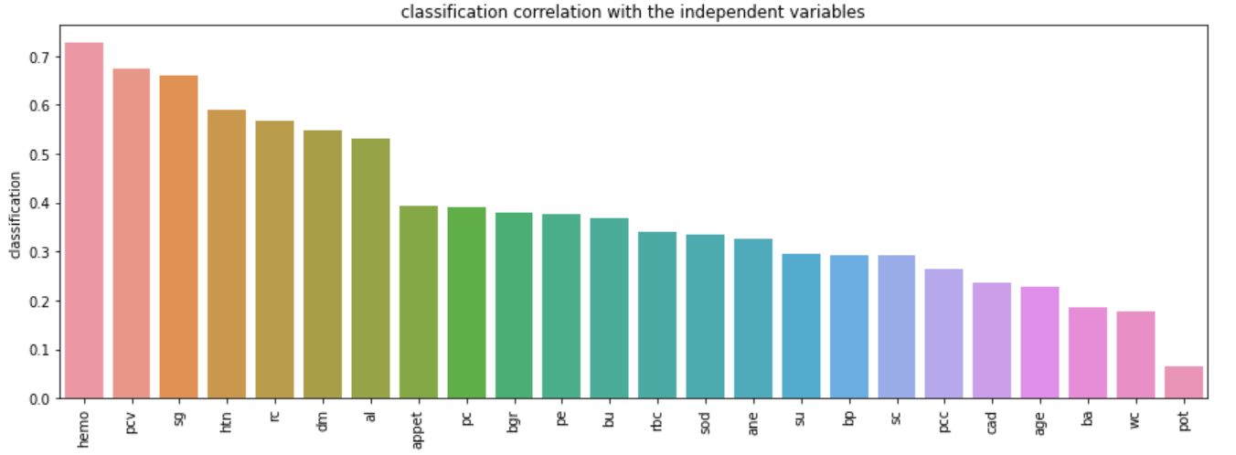
CORRELATION GRAPH TO INDEPENDENT VARIABLES

Slide 10
SELECTION OF PREDICTORS
su,bp,sc,pcc,cad,age,ba.,wc,pot
Appet,pcv,bgr,pe,bu,rbc,sod,ane
Hemo,pcv,sg,htc,rc,dm,al
Degree of impact on “Classification” Variable

Slide 11
04
PROJECT PLAN & EXECUTION
We employed these ML techniques and metrics

Slide 12



PROCESS
DATA PREPROCESSING
PREDICTION
SPLIT AND TRAIN THE DATA
Choose appropriate model, Train & Validate the Model (80-20)
Understand the business problem, collect and process the data
Evaluate the model through final predictors using ML Models, Hyperparameter Tuning, Visualization.

Slide 13
ML MODELS FOR PREDICTION
K-NN
DECISION TREE
LOGISTIC REGRESSION
K Nearest Neightbors
It’s a Decision Support Tool
Used for solving Binary Classification Problems
RANDOM FOREST
NEURAL NETWORKS
HYPERPARAMETER TUNING
Widely used in Classification and Regression,Builds Decision Trees on different Samples
It’s a series of algorithms, to be simple just mimics the way the human brain Operates.
Finding a set of optimal hyperparameter values for a learning algorithm

Slide 14
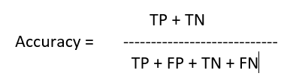



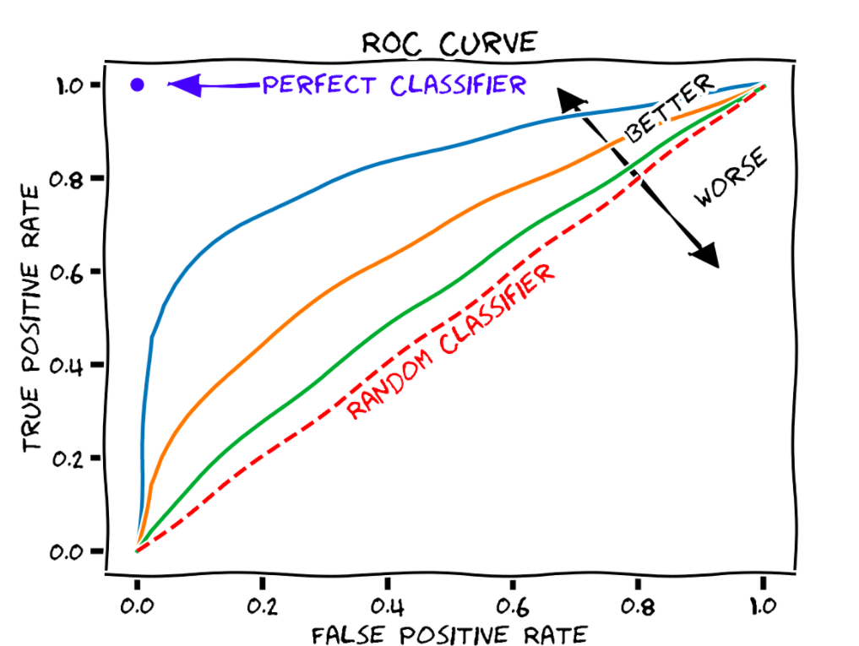
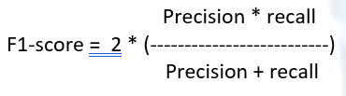
EVALUATION METRICS
ACCURACY
PRECISION
RECALL
F1-SCORE
CONFUSION MATRIX
ROC CURVES

Slide 15
MODEL OPTIMIZATION SCORE
True Positive (TP) – A Person's risk of CKD is accurately predicted, and their potential threat is real.
True Negative (TN) - Predicting that a person is not at risk for CKD and that they actually are not.
False Positive (FP) - Predicting that a person has CKD even though they do not.
False Negative (FN) - Predicting that a person is not only at risk for CKD but also has CKD.
We attempted to select a model with the highest recall score because a false negative would have a far higher negative impact on our forecast than a false positive.

Slide 18
Conclusion
The application of data mining techniques for data risk analysis is crucial in the health industry because it first empowers individuals to combat diseases and, as a result, saves lives by stopping treatment.
In order to minimize False Negative Prediction, all methods have been tuned to generate the highest Recall score.
Utilizing Hyper Parameter Tuning on Random Forest, we obtained the greatest result, fastest computation and highest recall score.

Slide 19
TEAM UPMOST
THANKS!
SECTION - 3

